Slide 1
The battle of neighborhood
New-York city

Slide 2

Introduction
In this project I'm going to use the location data to explore a geographical location of New-York.I will have the opportunity to use the Foursquare location data to explore, solve and compare neighborhoods of New-York.

Slide 3
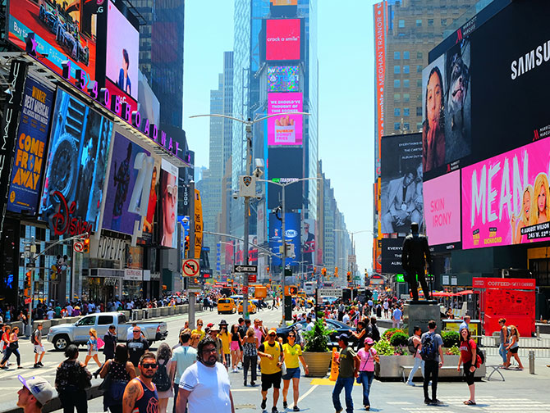
Dataset
This dataset has a total of 4 boroughs and 306 neighborhoods.
This dataset exists for free on the web
https://geo.nyu.edu/catalog/nyu_2451_34572

Slide 4
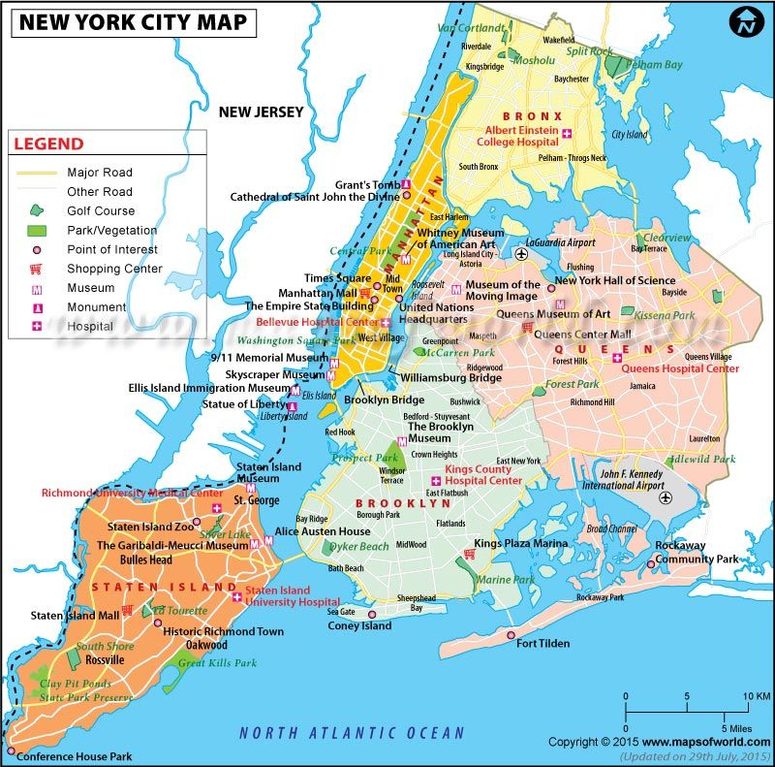
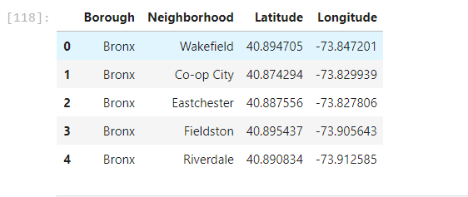
geograpical coordinate
New York City are 40.7127281, -74.0060152

Slide 5
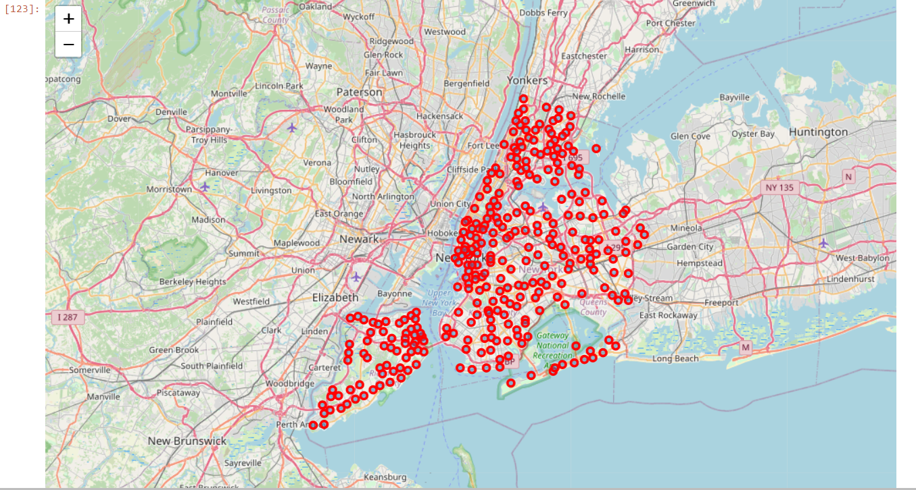
New York with neighbourhoods
We can see with this map that Manhattan have around 150 Neighborhoods
Each neighborhood is represent by a red circle
I use the library folio to display the map
Interactive map

Slide 6
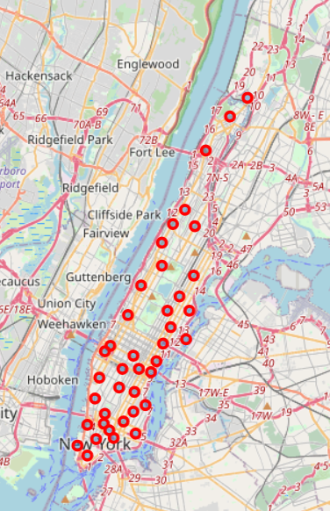
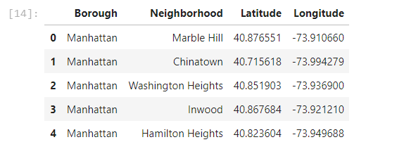
example of a few neighbourhoodS in Manhattan

Slide 7
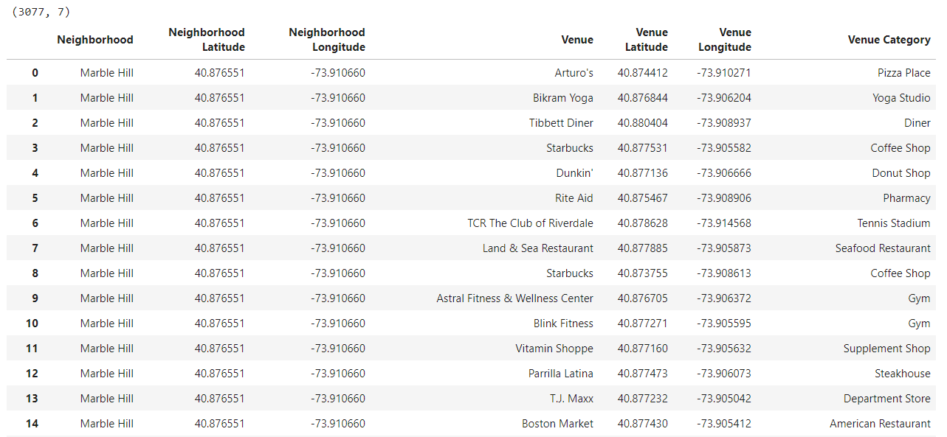
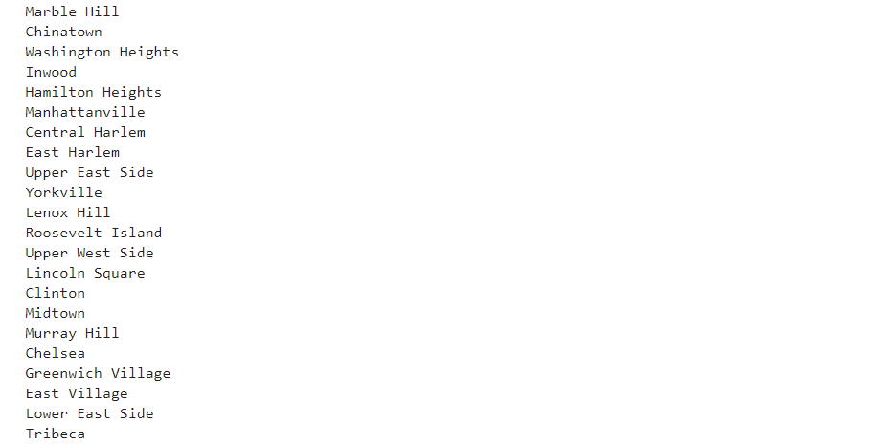
details of the Manhattan neighbourhoods
In Manhattan there are a lots of neighbourhood
Some names are here
With latitude and longitude

Slide 8
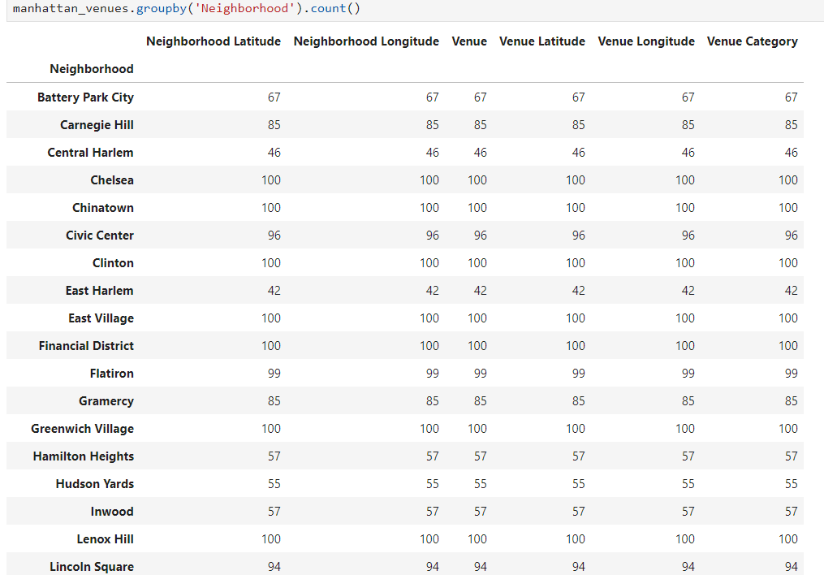
Group By one categorie
When I group by one categorie I can find 327 unique categorie

Slide 9
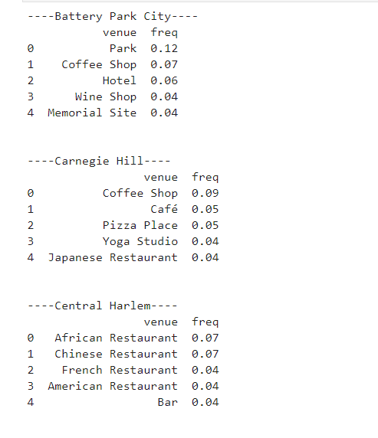
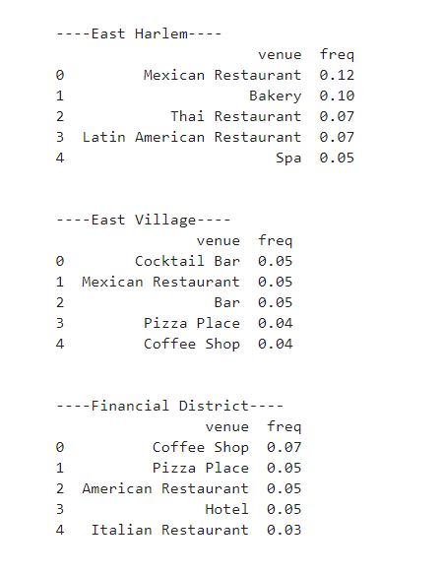

most popular “attraction” activities or work in a specific neighborhood
Here we can see the top five “best attraction” or “thing to do

Slide 10
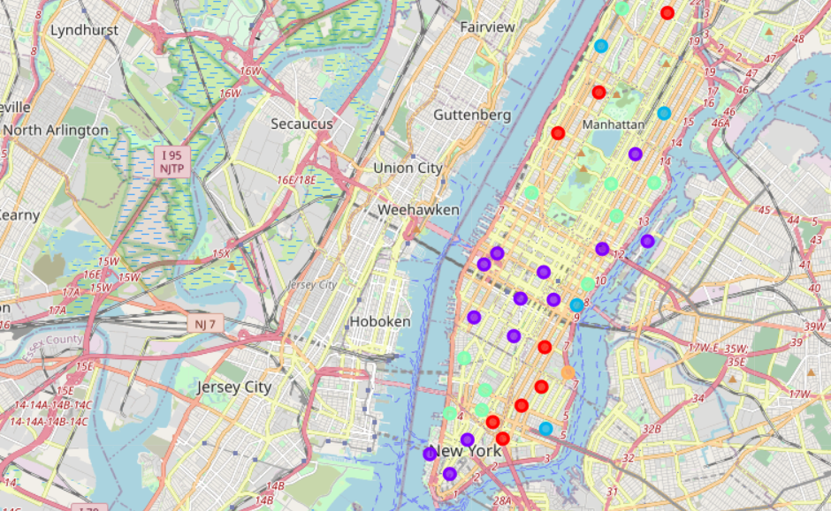
different borough of New-York
We can see in this part the different borough of New-York with a specific neighbourhood

